Slide 1
Better Together
Evaluation Team - Forecasting and Citation Recommendation

Slide 2
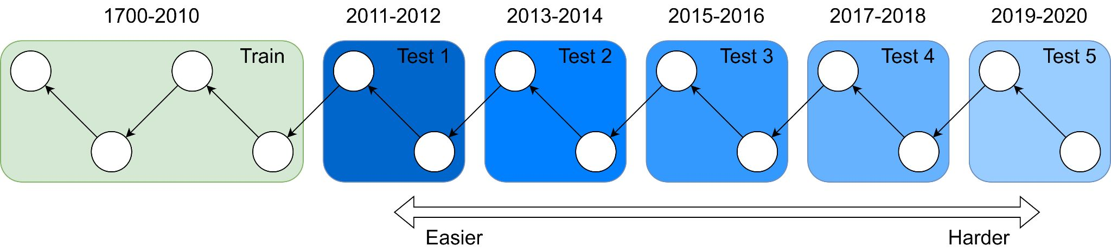
Forecasting
Intuition: as we try these tasks further out, things get muddier. If you’re an expert in 2010 what do you know about COVID, AlphaGo, South Sudan, etc?
Question: How to quantify this?
LLM: Perplexity of SciBERT across different bins, BPE compressibility
Better Together Eval: task performance at y+1, y+2, y+n (up to 2023*)

Slide 3
Evaluation should check forecasting capability
Make correct predictions repeatedly across a reasonable amount of time
Not interesting to ‘forecast’ into the past or the present
Deployed models typically have frozen parameters. Therefore they are always forecasting

Slide 4
Predicting 1 vs 2-4 Hops in the Citation Graph
Simple setting to evaluate train and test prediction ability
Random walk across the citation graph to form pairs of papers with minimum number of hops in [1,4].
Partition walks by the (time) bin of each paper
Score paper similarity with embedding cosine similarity across methods
Report how well cosine similarity distinguishes between 1 and 2-4 hops

Slide 5
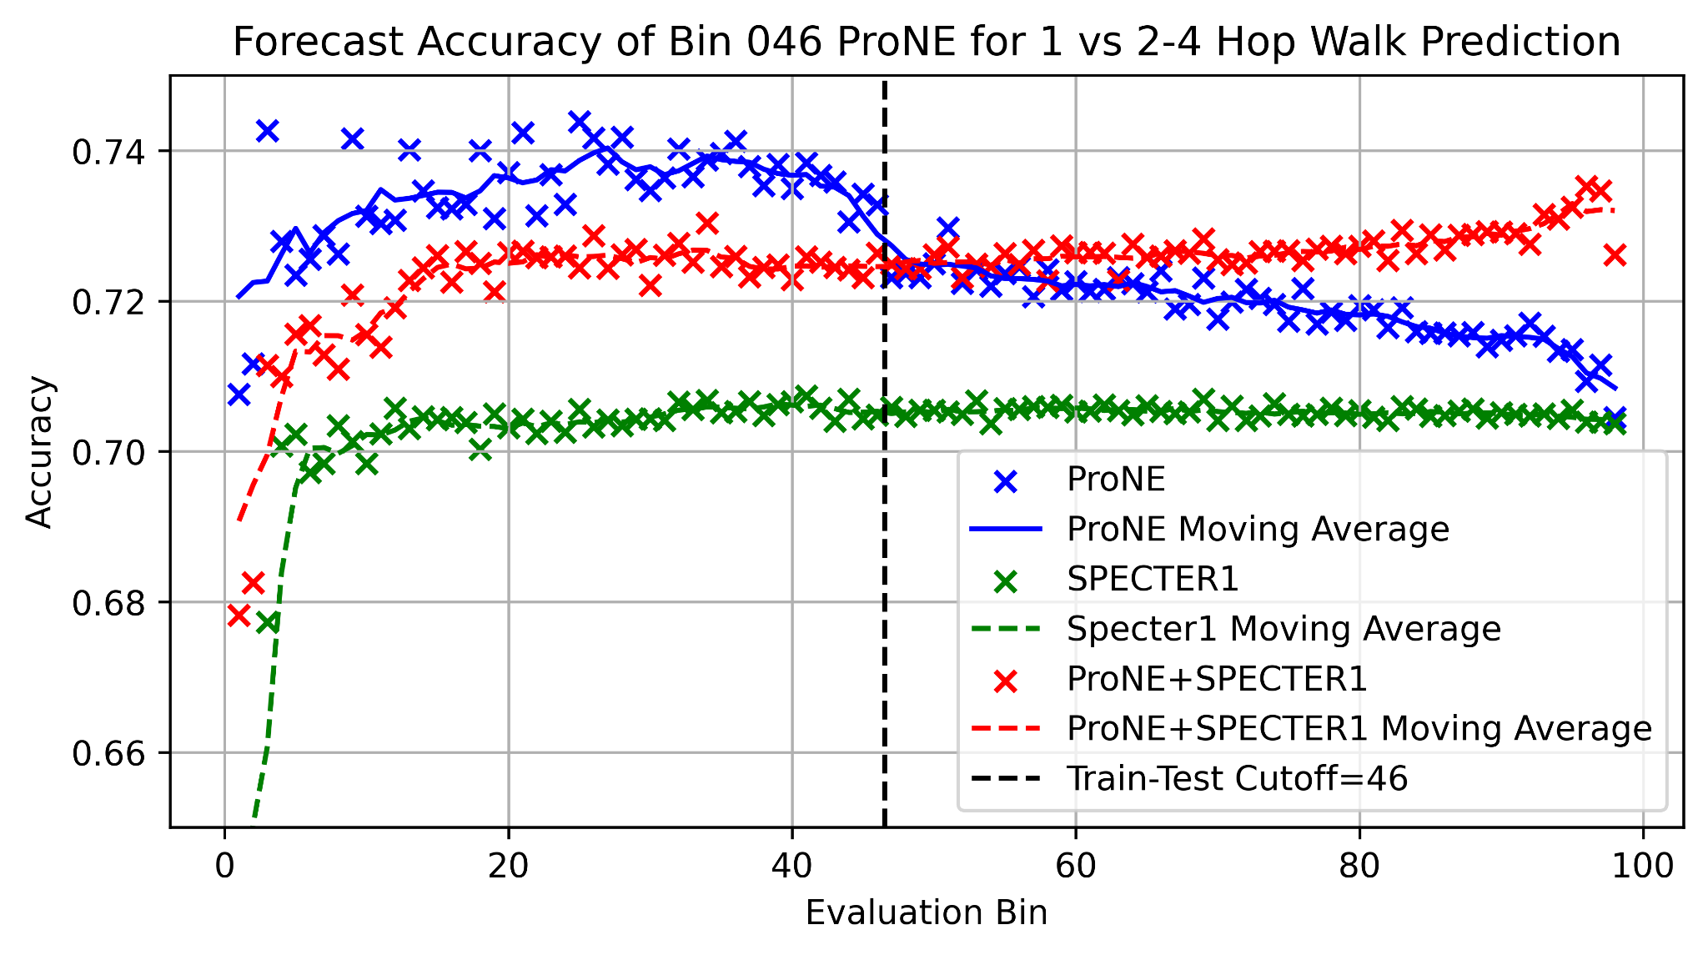
Predicting 1 vs 2-4 Hops in the Citation Graph
Remembering
Forecasting

Slide 6
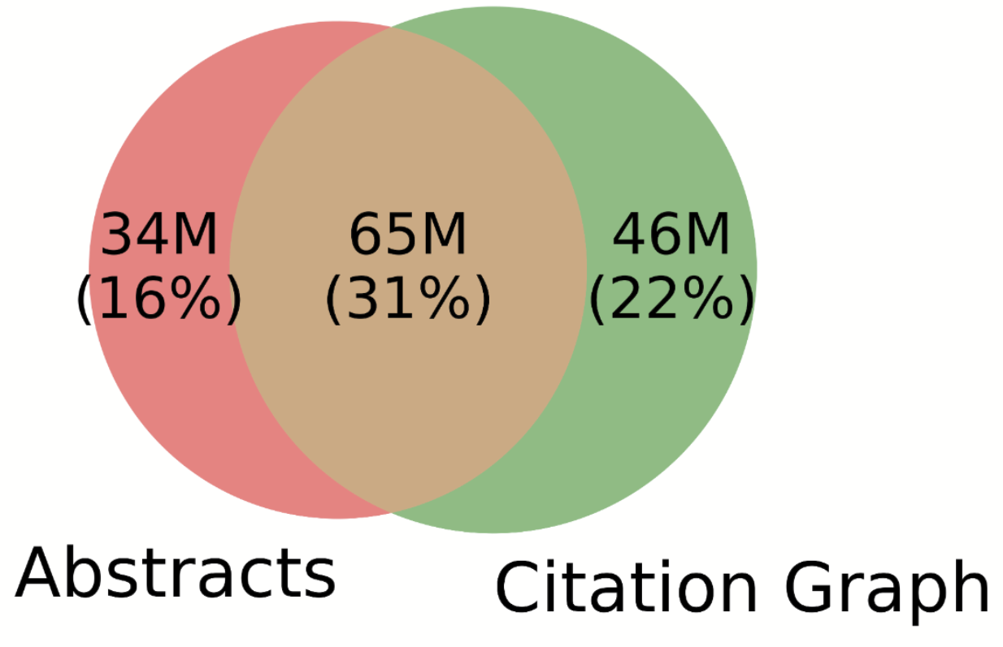
Predicting 1 vs 2-4 Hops in the Citation Graph
Specter1 significantly outperforms the random baseline
Can form novel ProNE embeddings by averaging embeddings of references in train
ProNE is better in all cases, even when forecasting far into the future
The further you get from the train split, the weaker the model’s predictions are
The best prediction comes from using ProNE with Specter as a fallback

Slide 7
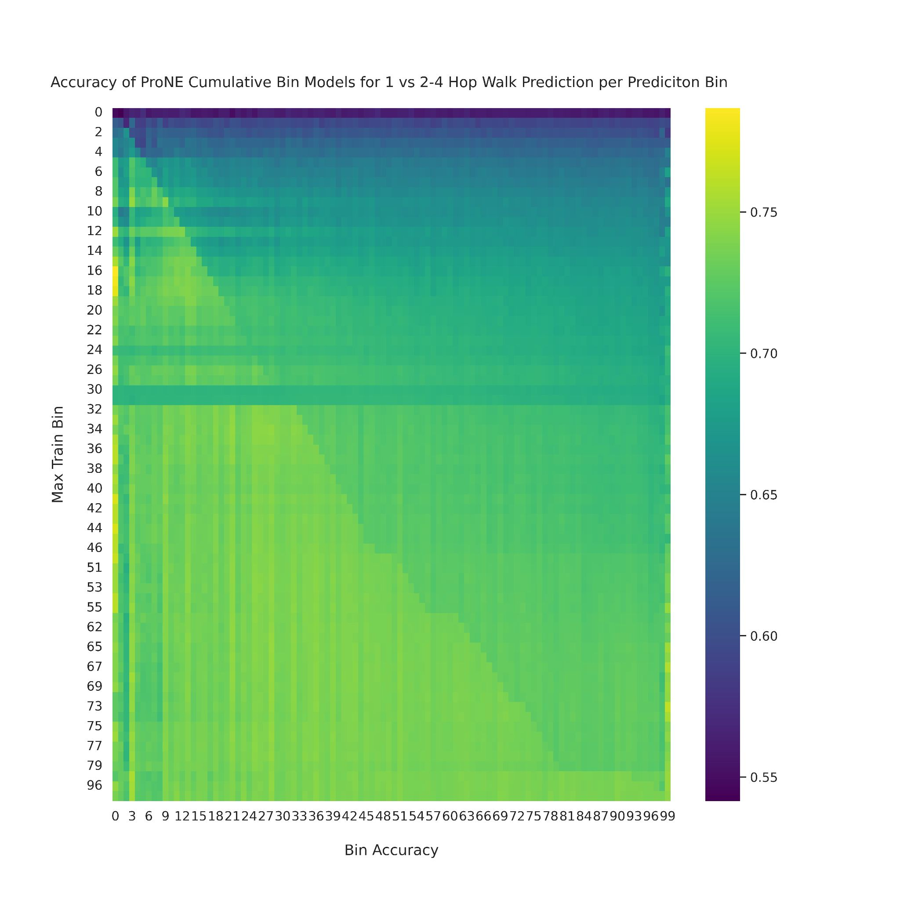
Across all Test/Train Splits
Looking across all ProNE bins we find:
The closer you train to a time point, the more accurate the model
The more time a model has seen, the better it does at some time point test/train+k

Slide 8
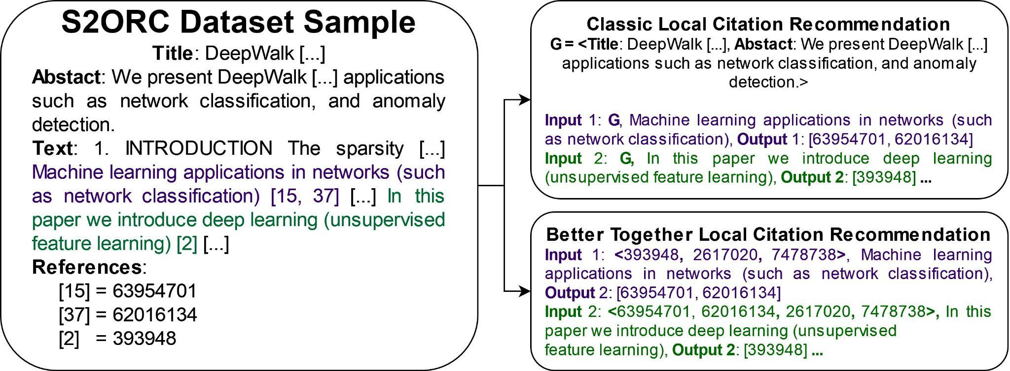
Extrinsic Evaluation – Local Citation Recommendation
Notes:
Refer to original paper before this. Link prediction refers to many things – earlier was one of simpler ones, whether i cites j. Introducing more complex problem
Reduce text
? answer, not q
use animations?
Emphasize task as predicting citations associated with citing sentence

Slide 9
Local Citation Recommendation Dataset
“What do I cite here?”
200M Papers, TK (>300M) citing sentences
Evaluation through nearest neighbour lookup of text/references
Record where in the retrieval list the ground truth reference appears
Can take the features of the source paper or other references
Can also weight features by their distance in the text document to the referencing sentence

Slide 10
Local Citation Recommendations - Text Vs Context
Specter1 Citing Sentences
Recall@1 0.0622
Recall@10 0.0988
Recall@100 0.1133
Recall@1000 0.1141
Specter2 Title + Citing Sentences
Recall@1 0.0033
Recall@10 0.0059
Recall@100 0.0067
Recall@1000 0.0067
SciNCL Source
Recall@1 0.0004
Recall@10 0.0143
Recall@100 0.0194
Recall@1000 0.0194
ProNE Source
Recall@1 0.0005
Recall@10 0.0684
Recall@100 0.1898
Recall@1000 0.2717
ProNE References
Recall@1 0.0093
Recall@10 0.0705
Recall@100 0.2068
Recall@1000 0.3068
ProNE References Weighted
Recall@1 0.01
Recall@10 0.0771
Recall@100 0.2156
Recall@1000 0.3195

